Slide 1
An Analysis Framework of Research Frontiers Based on The Large-scale Open Academic Graph
Xiaoguang Wang, Hongyu Wang, Han Huang
School of Information Management
Wuhan University, Hubei, China
wanghongyu@whu.edu.cn
JCDL 2019 Workshop 4, June 6
https://github.com/wanghongyu94/JCDL2019

Slide 2
CONTENT
01
INTRODUCTION
02
LITERATURE REVIEW
03
FRAMEWORK CONSTRUCTION
04
CONCLUSION
02

Slide 3
01
INTRODUCTION
PART ONE

Slide 4
1. Introduction——Background
Multiple Cooperation
Interdisciplinary Integration
Emerging Disciplines
A comprehensive, rapid, and accurate detection and analysis of the research frontiers is necessitated
to grasp the situation of sci-tech innovation and to optimize the allocation of scientific research resources
With the further development of the Open Science Movement, the large-scale open academic graph has gradually become the new dataset for the analysis of research frontiers due to the integration of scientific papers and their relevant metadata
Open Access
Open Data
An Analysis Framework of Research Frontiers Based on The Large-scale, Hongyu Wang, Wuhan University
04
Notes:
1、The increasing diversity of scientific research cooperation and innovation, the increasing complexity of interdisciplinary integration, and the emergence of new disciplines necessitate a comprehensive, rapid, and accurate detection and analysis of the research frontiers in various disciplines so as to help frontline researchers and sci-tech management departments to grasp the situation of scientific and technological innovation in a timely manner and to optimize the allocation of scientific research resources.
2、With the further development of the Open Science Movement (Evans and Reimer 2009), the large-scale open academic graph published by the major sci-tech information service providers has gradually become the new dataset for the analysis of research frontiers due to the integration of scientific papers as well as their relevant metadata, and the orderly organization of domain knowledge in scientific research. Moreover, it has created a better research condition for the future analysis of research frontiers.

Slide 5
1. Introduction——Analysis of Research Problem
The research frontier is a clustering structure among the highly interactive papers, which reflects the topic that have gradually interested people and have been studied more frequently over time
Analysis of research frontiers refers to the process of actively discovering and analyzing emerging research topics and their development status and associated structure by means of expert judgment and scientometrics methods.
Commonly used scientometrics methods of research frontiers analysis include co-citation analysis, bibliographic coupling analysis, word frequency analysis and co-word analysis, et al
Time-delay in citation analysis, lack of semantic information for topic analysis, and inability to cross-integrate of data sources are the main existing shortcomings due to the influence by data sources and analysis principles*
*Ruhai Bai,et al. Research on the Comparison of the Main Methods and Development Trends of Frontier Exploration in Scientific Research[J]. Information Studies:Theory & Application,2017
05
Notes:
The research frontier is usually reflected in the highly cited sci-tech Literature. It is a clustering structure among the highly interactive papers, which reflects the topic that have gradually interested people and have been studied more frequently over time. Analysis of research frontiers refers to the process of actively discovering and analyzing emerging research topics and their development status and associated structure by means of expert judgment and scientometrics methods.From different perspectives, scholars have proposed a number of scientometrics methods such as co-citation analysis, bibliographic coupling analysis, co-word analysis and so on. However, due to the influence of data sources and analysis principles, there are some shortcomings such as time-delay in citation analysis, lack of semantic information for topic analysis, and inability to cross-integrate of data sources.

Slide 6
1. Introduction——Paper Work
Pointing out the research optimization direction of the research frontier analysis
Investigating a specific academic graph
Summarizing the thoughts and steps of the analysis of research frontiers based on the open academic graph
Constructing an analysis framework of research frontiers based on the large-scale open academic graph
Research Frontiers
An Analysis Framework of Research Frontiers Based on The Large-scale, Hongyu Wang, Wuhan University
06
Notes:
Through the literature research, this paper sorts out the research optimization direction of the research frontier analysis. Further, the thoughts and steps of the analysis of research frontiers based on the open academic graph were summarized after the data structure investigation of a specific academic graph. Finally, an analysis framework of research frontiers based on the large-scale open academic graph was costructed systematically.

Slide 7
02
LITERATURE REVIEW
PART TWO

Slide 8
2. Literature Review——Conceptions and Methods of Research Frontiers Analysis
wholeness
coherence
perceivable
properties *
correlation
ostensive
Henry Small：
(Small H , Boyack K W , Klavans R . Identifying emerging topics in science and technology[J]. Research Policy, 2014)
Novelty
Growth
Scientometrics methods: citation-based; word-based
Others: comprehensive evaluation based on experts; multi-source data-based and multi-dimensional-based #
*Goldstein J . Emergence as a Construct: History and Issues[J].E m e r g e n c e, 1999
#Rui Luo, et al. A Review of the Main Recognition Methods of Frontier Research[J]. Library and Information Service, 2018
08
Notes:
The concept of research frontier was first proposed by Price in the 1960s. For decades, scholars have elaborated and defined its concept connotation from multi-dimension. coherence; correlation, wholeness; ostensive, and perceivable are the widely used description properties of the research frontier^{[2]}. Henry Small et al. pointed out that novelty and growth are two properties that are widely agreed of the research frontier.
At present, there are two main types of scientometrics methods used in the analysis of research frontier^{[6]}. One is the citation-based method such as co-citation analysis and bibliographic coupling analysis, and the other is the word-based analysis methods such as word frequency analysis, co-word analysis and probabilistic topic model. In addition, there are also some methods, such as comprehensive evaluation of the frontier based on the experience of experts, and identification and analysis of the frontier based on time series, multi-source data or multi-dimensional indicators.

Slide 9
2. Literature Review——Conceptions and Methods of Research Frontiers Analysis
The premise of research frontiers analyze is to extract the subject topics from data sources
Subject topics are word representation of the research content in a discipline
Extraction of subject topics: Candidate Keyword Generation, Feature Engineering, and Keyword Extraction *
After extraction, how to judge the state and change tendency of the subject topics is one of the difficulties in frontier analysis
Classic Methods: Word Analysis (burst detection and the co-word analysis) and Topic Analysis (topic model)
Novel Method: Extracting the core nodes in the community of co-words so as to analyze the evolution process of subject topic and its characteristics#
Multi-dimensions：
TF-IDF
Co-occurrence
CiteTextRank
LDA/Word2Vec
*Yaocheng Chang, et al. ﻿Features Oriented Survey of State-of-the-Art Keyphrase Extraction Algorithms[J]. Journal of Software, 2018
#Analyzing evolution of research topics with NEViewer: a new method based on dynamic co-word networks[J]. Scientometrics, 2014
09
Notes:
The premise of analyzing the research frontiers in various disciplines is to extract the subject topics from data sources, such as scientific papers. The subject topics are word representation of the research content in a discipline. The extraction of subject topics can be carried out by means of keyword extraction, through the three main steps of candidate keyword generation, feature engineering, and keyword extraction, driven by the characteristics of multiple dimensions.
In the word frequency dimension, the classical term frequency–inverse document frequency algorithm and its derived algorithms can be used to quantify the keywords. In the dimension of co-occurrence characteristics among words, the semantic relationship between candidate words is judged according to the number of co-occurrences of the words. Besides, the number of co-occurrence of citations and word embedding vector characteristics, such as Word2Vec have also been used for keyword extraction and gradually received more attention.
Judging the state and change tendency of subject topics is one of the difficulties in frontier analysis. Numerous methods and models have been proposed to solve this problem, which can be divided into two types according to different granularity: word analysis and topic analysis. The word analysis method includes the burst detection algorithm and the co-word analysis method. Moreover, the topic analysis method integrates feature indicators of research frontiers into the topic model and then constructs a classifier to detect new topics. With the expansion of the data analysis scale and the application of complex network mining ideas, a novel method for research frontier analysis was proposed based on the co-word analysis method. That is, an algorithm was designed to extract the core nodes in the community of co-words so as to analyze the evolution process of subject topics and its characteristics.

Slide 10
2. Literature Review——Research Optimization Direction of Frontier Analysis
Limited by the influence of data source/data scale/analysis principle, failed to achieve deep, relevant, and dynamic analysis of research frontiers in a multidimensional, large-scale, and fine-grained manner：
Strengthen Depth and Breadth
It is necessary to collect data from multiple disciplines for in-breadth and in-depth analysis.
Focus on Dynamic Changes
The scientometrics analysis should focus more on the dynamic evolution of citations and distribution of research topics.
Extended Data Sources
The analysis of research frontiers through multi-source data can obtain more comprehensive, accurate and objective results.
Pay Attention to Multi-factors
Exploring the correlative changes of multi-factors from the perspective of individual topic and group topic can reveal the development of research frontiers more profoundly.
Improving Intelligence
Under the support of academic big data, intelligent models of feature selection and weighting can be established through techniques such as machine learning, thereby reducing manual intervention.
An Analysis Framework of Research Frontiers Based on The Large-scale, Hongyu Wang, Wuhan University
12
Notes:
Limited by the influence of data source/data scale/analysis principle, current research failed to achieve deep, relevant, and dynamic analysis of research frontiers in a multidimensional, large-scale, and fine-grained manner。
Strengthen depth and breadth：There are cross-correlations between research topics in different disciplines, which affects the emergence and development of specific research frontiers. For the analysis of research frontiers, it is necessary to collect data from multiple disciplines for in-breadth and in-depth analysis.
Focus on dynamic changes:The citation of papers and the distribution of topic words changed over with time. The scientometrics analysis of research frontiers should focus more on the dynamic evolution of citations and distribution of research topics over time.
Extended data sources:Research frontiers are embodied in the data of science and technology planning/research projects/funds/patents/scientific papers. Therefore, the analysis of research frontiers through multi-source data can obtain more comprehensive, accurate and objective analysis results.
Pay Attention to Multi-factors:Multi-factors such as journals/scholars/institutions/technical projects and funds influence the evolution of research topics synergistically. Therefore, exploring the correlative changes of multi-dimensional factors from the perspective of individual topic and group topic can reveal the development of research frontiers more profoundly.
Improving Intelligence: At present, some frontier analysis depend on experts to select and weight multi-dimensional features. Under the support of academic big data, intelligent models of feature selection and weighting can be established through techniques such as machine learning, thereby reducing manual intervention.

Slide 11
2. Literature Review——The Construction and Application of Open Academic Graph
High-quality
Rich-semantics
Good-structure
Open Academic Graph(OAG): using semantic technologies to fulfill the representation and organization of sci-tech papers and their relevant information and knowledge, and allowing open access to the Internet.*
Typical open academic graphs :
SciGraph
MAG
Aminer
The key support of OAG is knowledge graph, which is a new technology of rich semantic knowledge representation. It realizes fine-grained and deep-level knowledge organization and representation. The main construction process of it includes information extraction, knowledge fusion and knowledge processing.#
*Lei Xu,et al. Semantic data of scientific publications and their applications[J]. Chinese Journal of Scientific and Technical Periodicals, 2018
#Qiao Liu, et al. Knowledge Graph Construction Techniques[J]. Journal of Computer Research and Development, 2016
10
Notes:
Open academic graph is an organizational pattern of knowledge and data related to scientific research. It organizes various objects in the scientific research process, the journal publishing process and the academic conference cycle through some semantic technologies such as ontology, resource description framework, and linked data to realize the semantic linking of scientific publishing data. Further, it allows open access to the Internet. Typical open academic graphs include the Springer&Nature Group's SciGraph, Microsoft's Microsoft Academic Graph - MAG^{[22]}, and Tsinghua University's Sci-tech Information Service Platform – Aminer.
The key support of open academic graph is knowledge graph, which is a new technology of rich semantic knowledge representation introduced by Google in May 2012. It realizes fine-grained and deep-level knowledge organization and representation with excellent semantic relevance and computability which effectively support the development of semantic retrieval, intelligent Q&A and so on. Therefore, knowledge graph construction oriented to specific fields and tasks is gradually has gradually become a research hotspot. The main construction process of knowledge graph includes three steps: information extraction, knowledge fusion and knowledge processing.
As a high-quality knowledge graph dataset in scientific research, the open academic graph have been lay a solid data foundation for the optimization of research frontier analysis.

Slide 12
2. Literature Review——The Construction and Application of Open Academic Graph
Constructing high-quality academic knowledge graph and exploring its application in sci-tech information analysis has gradually attracted the attention of scholars
The unified modeling method and semantic information matching
algorithm of heterogeneous objects in the scientific knowledge network was proposed
The feasibility of frontier analysis based on OAG was confirmed from the researcher portrait construction and paper impact analysis
An Analysis Framework of Research Frontiers Based on The Large-scale, Hongyu Wang, Wuhan University
11
Notes:
Focusing on scientific research, how to construct a high-quality academic knowledge graph and explore its application in the analysis of sci-tech information has gradually attracted the attention of scholars. In the process of constructing academic knowledge graph, Tang Jie's team designed a unified modeling method for heterogeneous objects of sci-tech knowledge network and improved the accuracy of semantic information extraction in scientific research by the multi-dimensional dependency information extraction method and the semantic integration framework based on minimum risk. Furthermore, the COSNET model was designed to match the information on social network so that the metadata of scientific papers in Aminer is enriched. Microsoft Research Institute has explored the algorithms of organization, discovery and merger of six kinds of scientific research entities in the process of constructing MAG. At the application level, some scholars have carried out text analysis and citation analysis through the academic knowledge graph, and have portrayed and analyzed the researchers from two aspects of professional ability and academic authority. Other scholars have studied the quantitative method of relative citation times, comprehensively considered the different reference habits between different fields, the different propensity between new and old papers, and reduced the problems caused by directly sorting by citation using academic knowledge graph. These above studies confirm the feasibility of frontier analysis based on open academic graph.

Slide 13
03
FRAMEWORK CONSTRUCTION
PART THREE

Slide 14
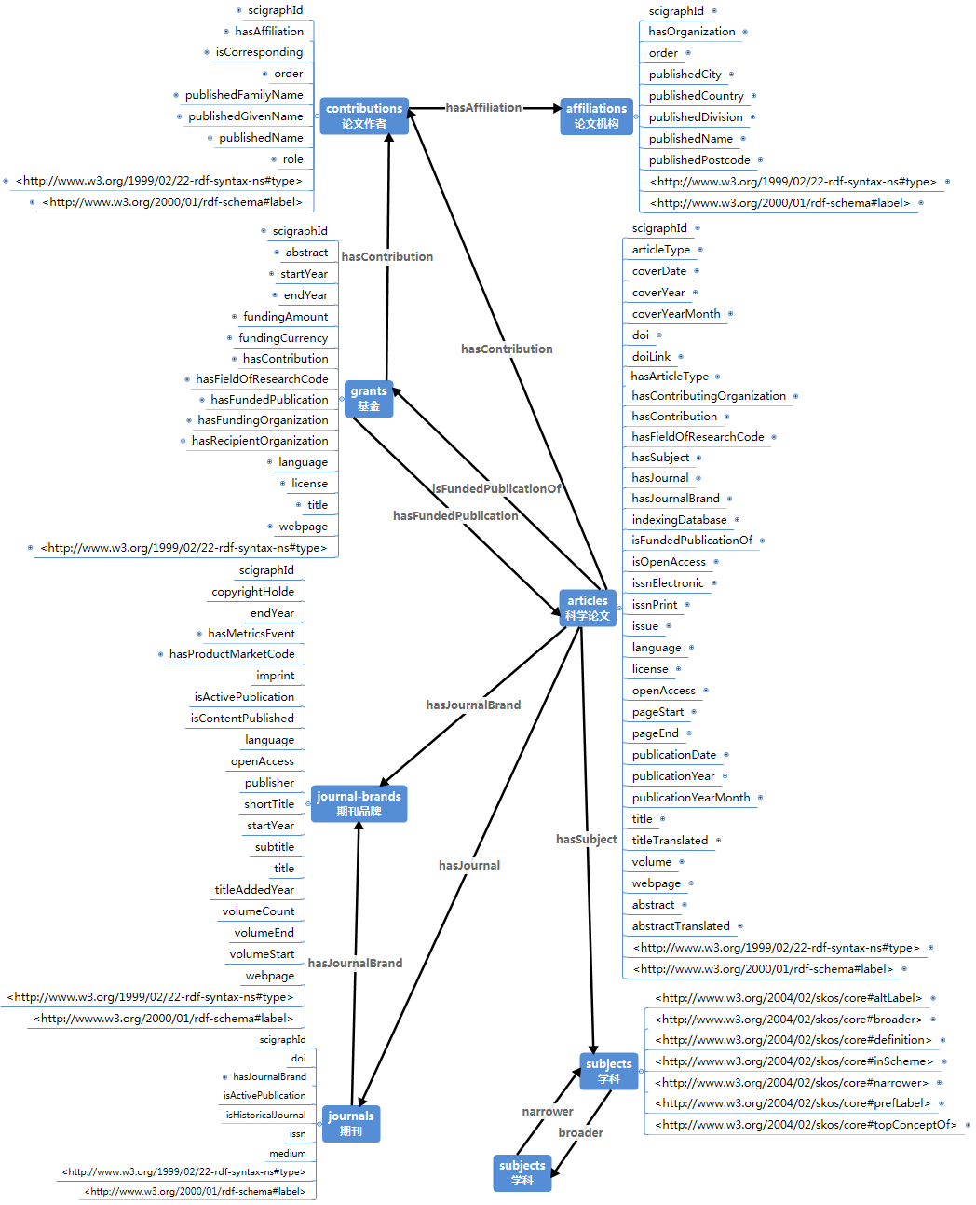
3.Framework Construction——The Investigation of Open Academic Graph Data Structure
The basic conditions for research frontier analysis using large-scale OAGs have been already available
SciGraph is a graph stored in the form of triples, which integrates the data of papers and their relevant information
By 2017, SciGraph had released metadata for more than 10 million papers, and nearly 1 billion triple data in 12 categories related to it.
Discovering the evolution process of subject topics in multi-dimensions and exploring the development tendencies of research frontiers so as to realize the accurate analysis of research frontiers
An Analysis Framework of Research Frontiers Based on The Large-scale, Hongyu Wang, Wuhan University
14
Notes:
With the development of technologies such as text mining, natural language processing, big data and machine learning, the basic conditions for research frontier analysis using large-scale open academic graphs have been already available.
Both Aminer and MAG organize and store the related attributes of scientific papers according to the relational model. On the other hand, SciGraph is a graph stored in the form of triples, which integrates the data of papers and their relevant information. The model used to organize the data of main categories in SciGraph is shown in Figure 1 according to the investigation.
By 2017, SciGraph had released metadata for more than 10 million papers based on the above model, and nearly 1 billion triple data in 12 categories related to it.
Through these data, it is convenient to discover the evolution process of subject topics in the dimensions of communication, attention, and fund, and explore the development tendencies of research frontiers based on multilevel factors, such as grant support, journal publication, and paper citation, and thus realize the accurate analysis of research frontiers.

Slide 15
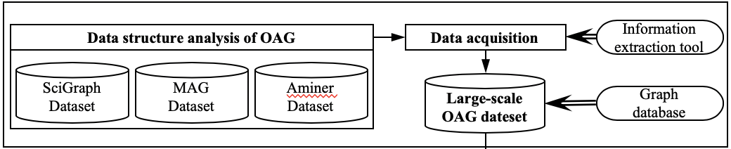
3. Framework Construction——Overall Framework Construction
Open Data Acquisition：
In this framework, it was necessary to design unified mapping rules based on the data structure of various academic graphs first to complete standardized information acquisition and graphical storage of the multisource heterogeneous large-scale open academic graph.
An Analysis Framework of Research Frontiers Based on The Large-scale, Hongyu Wang, Wuhan University
15
Notes:
Owing to the multi-source and heterogeneous characteristics of OAGs, it was necessary to investigate the structure and organization of SciGraph, MAG, Aminer and other open academic graphs and design an unified mapping rules for all kinds of OAGs. Through programming and mature information extraction toolkit, the information acquisition and storage of large-scale open academic graph was realized. Afterwards, because of the different number and organization of articles recorded in various OAG, it was necessary to design a semantic distance calculation method by using Semantic ontology library technology (WordNet and HowNet), apply knowledge fusion tools, and implement entity links, knowledge combination and alignment among different OAGs based on Aminer COSNET and other academic graph linking algorithms, and then combine with the graph database technology (Neo4j, Virtuso, etc.) to complete the fusion and storage of the large scale open academic graph.

Slide 16
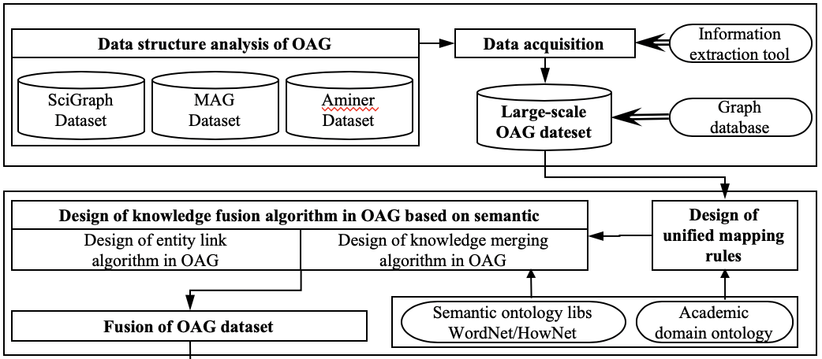
3. Framework Construction——Overall Framework Construction
Academic Graph Fusion：
The semantics-based knowledge fusion algorithm, which is used to complete the entity links, knowledge merge, and alignment between large-scale academic graphs, was designed with reference to the Aminer’s algorithm.
An Analysis Framework of Research Frontiers Based on The Large-scale, Hongyu Wang, Wuhan University
16
Notes:
The semantics-based knowledge fusion algorithm should include the following two steps:
In open academic graph A, the title of each item in open academic graph B is queried iteratively and the link matches all candidate articles.
If most of the conditions of title similarity, author number similarity, author list similarity, publishing year similarity, publishing journal similarity and research field similarity are satisfied between the target article and the single candidate article, they can be linked, and the relevant attributes of the articles in different open academic graph can be merged and aligned.

Slide 17
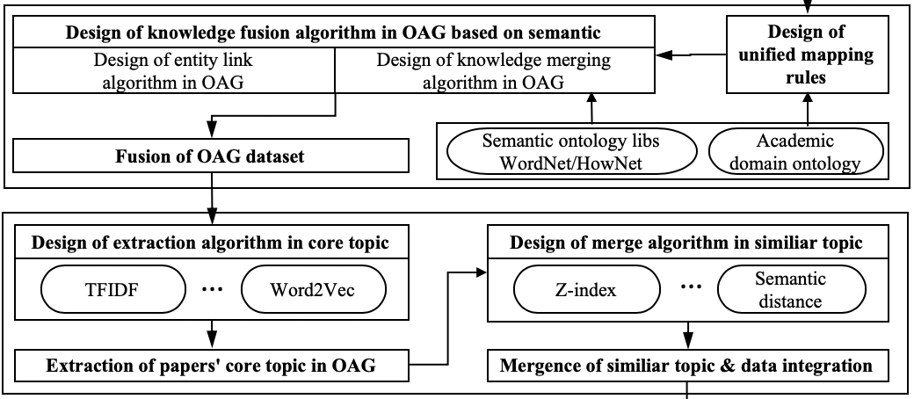
3. Framework Construction——Overall Framework Construction
Core Topic Extraction：
The core topics in the dataset were extracted according to multi-features, such as word frequency, word embedding vector, and topic model, and the similar topics were merged through the designed merge algorithm.
An Analysis Framework of Research Frontiers Based on The Large-scale, Hongyu Wang, Wuhan University
17
Notes:
By observing the data structure of several open academic graph, it can be found that some OAG lack information about the topic, and only have information about the title, abstract, keyword and research field of the paper. Therefore, it is necessary to use English part-of-speech tagging tools and Chinese word segmentation toolkits to perform word segmentation (Chinese only) and part-of-speech tagging for the data items such as the title and abstract of the papers in OAG. After word-of-speech screening and stop word processing, the word frequency are accurate and the candidate keywords are extracted. Then, driven by the characteristics of word frequency (TFIDF and its optimization algorithm), word relationship (analysis of co-occurrence of a single article and citations), word embedding vector (Word2Vec) and topic model (LDA), the core topic of the paper is determined. Then, according to the core topic extracted from the paper, the similar topic merging algorithm is designed to merge and measure the topics, and the related information of papers in OAG is correlated, the OAG data is completed with the topic as the main line, which lays the data foundation for subsequent topic evolution analysis and frontier analysis.

Slide 18
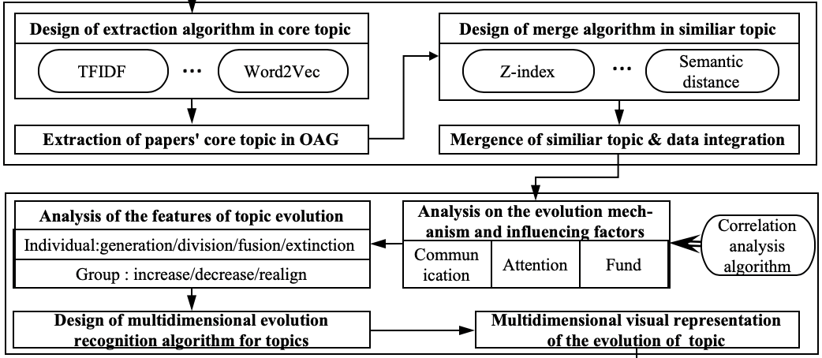
3. Framework Construction——Overall Framework Construction
Multi-dimensional Evolution Analysis：
The evolution mechanism and influencing factors of subject topics were analyzed using the correlation analysis algorithm from multi-dimensions. The expression of topics generation in the academic graphs were revealed to achieve multidimensional evolution analysis and visual representation of topics in the large-scale OAG.
An Analysis Framework of Research Frontiers Based on The Large-scale, Hongyu Wang, Wuhan University
18
Notes:
Afterwards, the structure OAG is mined by the association analysis algorithm such as Aprior and the evolution mechanism and influencing factors of subject topics is analyzed from the communication dimension, attention dimension and funding dimension. Secondly, the manifestations of various processes of generating, splitting, intersecting, integrating and fading of scientific research topics in the open academic graph is studied from the perspective of subordinate fields related to subject topics such as journals, grant funds, researchers, et al, and the time series analysis model is constructed to carry out the multidimensional evolution analysis and visual representation of the subject topics in the large-scale open academic graph.

Slide 19
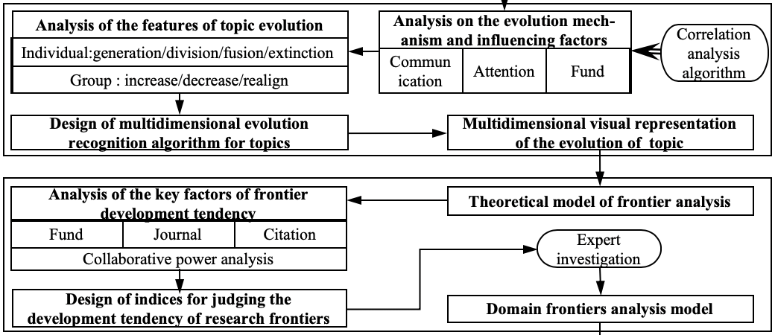
3. Framework Construction——Overall Framework Construction
Frontier Analysis：
A collaborative analysis of the evolution process of individuals and groups in multi-terms was completed. Then, the multivariate indices of the frontier development tendency were designed and the analyzing model of the research frontiers was constructed.
An Analysis Framework of Research Frontiers Based on The Large-scale, Hongyu Wang, Wuhan University
19
Notes:
Next, the collaborative analysis of the evolution process of individuals and groups in multi-terms such as journal attention, fund support preference and researcher's interest was completed, and the main influencing factors and discriminant indicators of frontier development trend are analyzed by combining statistical analysis and communication analysis so as to construct the model of frontier analysis. Under the frontier analysis model, the characteristics of the frontier in discipline are qualitatively and quantitatively.
the weights of each characteristics which influencing the emergence and development of the frontier are determined according to the subject background ontology and a semantic weighted discriminant model for measuring the frontier value is proposed. After that, the parameters of the model are optimized and adjusted based on the survey and interview opinions of domain experts.

Slide 20
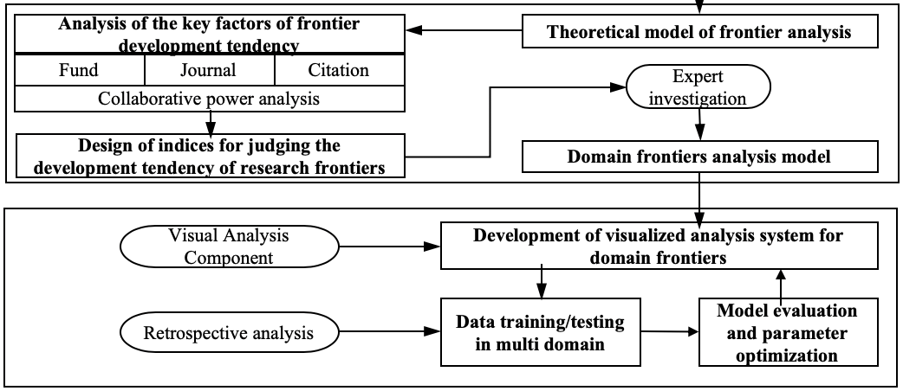
3. Framework Construction——Overall Framework Construction
System Development & Experiment：
A visualized analysis system of research frontiers was developed. Through the training data in various disciplines, the performance of the system was evaluated and optimized, and the comprehensive and accurate analysis of research frontiers was finally realized.
An Analysis Framework of Research Frontiers Based on The Large-scale, Hongyu Wang, Wuhan University
20
Notes:
Finally, the system functions and modules are designed based on the frontier analysis model and the expert researches, and a visual analysis experimental system of research frontiers is developed. The application experiments which aims at many specific areas of in open academic graph are carried out on the system to verify the reliability and credibility of the frontier analysis results. Then the parameters and functions of system are optimized combined with the suggestions of experts. Finally, it is possible to use the advanced system to conduct visual analysis and application research for multiple subject areas.

Slide 21
04
CONCLUSION
PART FOUR

Slide 22
4. Conclusion and Discussion
Conclusion
Analyzing the optimizing direction in the following frontier research, putting forward the research thoughts and steps of frontier analysis based on OAG, suggesting the main algorithms and tools to be used, and cconstructing an overall framework of frontier analysis based on OAG.
Expectation
OAG has created new research conditions for dynamic analysis across time and space, multiscale evolution analysis, multidimensional analysis under multi-factors, and automated intelligent analysis of research frontiers.
Discussion
There are still some problems, such as the time and space complexity of large-scale dataset analysis and calculation, the intuitive visualization of the evolution process of complex subject topics.
An Analysis Framework of Research Frontiers Based on The Large-scale, Hongyu Wang, Wuhan University
22
Notes:
Based on the literature review of the research frontiers and the open academic graph, this study analyzed the optimizing direction in the following frontier research, such as strengthen depth and breadth, focus on dynamic changes, extended data sources, pay attention to multi-factors and improving intelligence. Combined with the data structure analysis of the open academic graph, this study further put forward the research thoughts and steps of frontier analysis based on the open academic graph and made suggestions on the main algorithms and tools to be used. Thus, an overall framework of frontier analysis based on the open academic graph was constructed.
The open academic graph has created new research conditions for dynamic analysis across time and space, multiscale evolution analysis, multidimensional analysis under multiple factors, and automated intelligent analysis of research frontiers. With the increasing fusion of knowledge between large-scale academic graphs and other open data in the scientific research area, it is possible to further complete a more comprehensive and accurate analysis for research frontiers and effectively realize the data-driven knowledge discovery in the future.
In the current environment, when analyzing the frontier based on OAG, there are still some problems, such as the time and space complexity of large-scale dataset analysis and calculation, the intuitive visualization of the evolution process of complex subject topics, which need to rely on the advancement of distributed big data computing technology, data visualization technology, and natural language processing.

Slide 23
Wuhan
University
THANK YOU
For Your Listening !
Hongyu Wang

